Slide 1
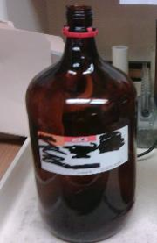
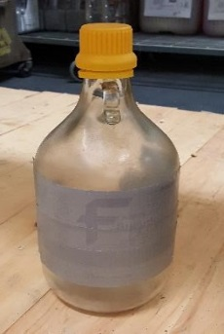
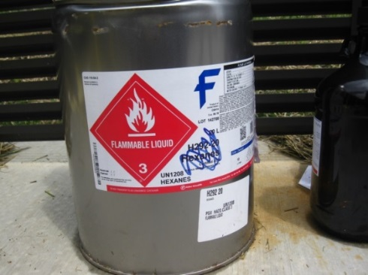
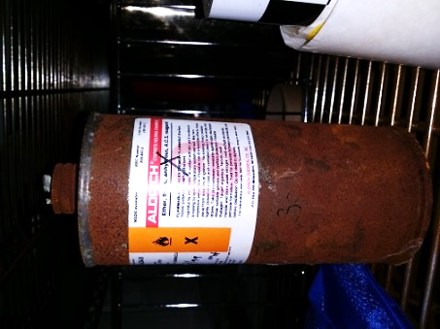
AUTHORIZED EMPTY CONTAINER DISPOSAL OPTIONS
✓
RE-USE:
For containers suitable for waste collection of same or similar chemicals/solutions/compatible mixtures.
Some empty solvent bottles can be repurposed without rinsing, if already dry --
EXAMPLES: acetonitrile, methanol, isopropanol, acetone, ethanol, hexane, cyclohexane, chloroform
Deface information on label fully (tape over with duct tape, mark out with Sharpie, or remove label).
Apply labeling in legible English that says “WASTE” & lists all chemical constituents, and primary hazards.
Re-use for compatible waste only -- no acidic/basic waste in metal; no azide compounds in metal.
5-gallon containers: Re-use for compatible waste only (or request EHS pickup for repurposing by others).
PROPERLY DEFACED
DISCARD:
Empty containers of less hazardous chemicals – must be completely empty & dry (e.g. solvents) or have been rinsed with a small amount of liquid; rinsate must be collected as liquid chemical waste.
No residue at all should be left in containers for dumpster disposal!
Deface the labels on containers, then place containers in defaced cardboard carton.
Close & tape carton securely; mark carton as “EMPTY GLASS CONTAINERS” or “BROKEN GLASS CONTAINERS.”
Dispose of taped cartons in dumpster at your building, taking care to not shatter glass or break open the cartons upon disposal.
IMPROPERLY DEFACED
REQUEST
EHS
PICKUP:
For containers of ACUTELY HAZARDOUS WASTE (“P List” chemicals, strong oxidizers, aggressive
acids/ bases, etc. EXAMPLES: sodium azide, carbon disulfide; see EHS website for others.)
Submit a waste pickup request through EHS. Do not rinse.
This is a good option when:
(1) you do not want to rinse the container and create new liquid waste.
(2) it was a very hazardous chemical.
(3) it is a 5 gallon carboy that you do not want, but can be used elsewhere on campus.
VT Environmental Health & Safety 2019

