Slide 1
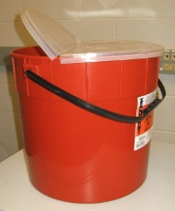
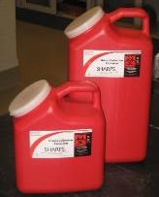
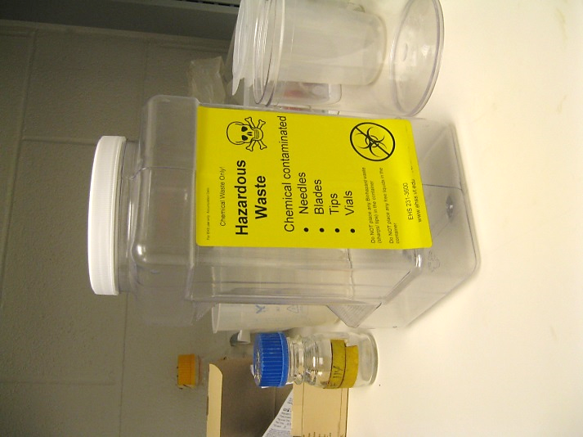
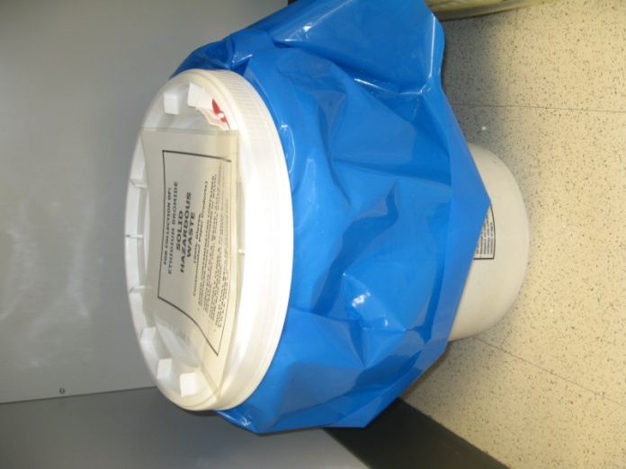
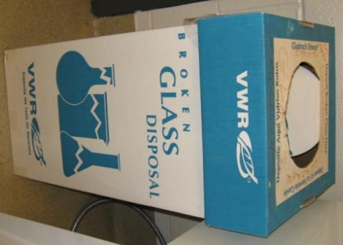
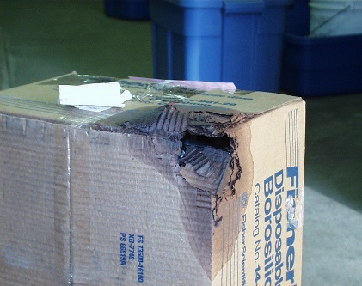
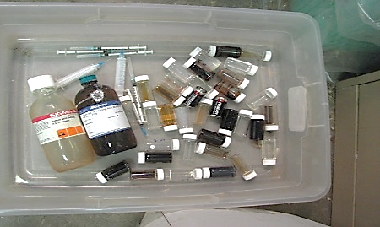
PROPER DISPOSAL OF BROKEN GLASS
CONTAMINATED WITH BIOLOGICALS
CONTAMINATED WITH CHEMICALS
(not P-listed or high hazard):
Put on disposable gloves and lab coat.
Pick up broken glass with forceps or tongs.
Place broken glass pieces in Sharps container(s).
Disinfect area/surfaces where break occurred.
Remove PPE; wash hands.
Autoclave Sharps container for decontamination,
then discard in RMW.
7. Request pickup of full, packaged RMW from EHS using the online request form.
Put on disposable gloves and lab coat.
Pick up broken glass with forceps or tongs.
Place broken glass in:
Chemical Sharps container if smaller volume
Chemical Waste bucket if larger volume
4. Request pickup of waste from EHS using online request form.
✓
✓
✓
CLEAN BROKEN GLASS
Dispose of uncontaminated, clean broken glass in:
designated boxes like this, or
in any sturdy cardboard carton that you LABEL WELL: “BROKEN GLASS
DISPOSAL—UNCONTAMINATED ONLY”
Always line boxes with trash bags.
When full (DO NOT OVERFILL), close the box, seal it securely with tape & discard CAREFULLY in or near dumpster for waste contractors to remove—this is the responsibility of lab personnel, not Housekeeping staff.
NOTE: BROKEN GLASS BOXES ARE NOT LAB WASTE CATCH-ALLS!
✓
Cardboard corrosion shows glass within was not clean . . . or properly emptied.
Glass should NOT go into this stream if it still has chemicals within . . . and isn’t broken!
VT Environmental Health & Safety 2015

